Slide 1






API Portal for API publishers and consumer to interact without any interlock
HPE API Publisher
HPE API Consumer
API Developer/Consumer Store
API Publisher Application
API Store Application
Publish
Manage
Configure
Monitor
Find
Evaluate
Explore
Subscribe
API
API
API Catalog
Tiers/Plans
API Catalog
Creators Publishers
API Consumers
Publisher Features
Consumer Features
Notes:
Borrowed from https://market.mashape.com/features
Title:
Allow HPE developers to access data and capabilities without any interlock!!
Consumer Features
Rich API documentation including interactive trying of API methods.
Self service client application registration to consume APIs. Zero Interlock!!
Seamless integration with Cyber Security Oauth 2.0 Token Service.
Consumer’s view of his API Metrics.
Publisher Features
Easy publication of APIs including HPE specific meta-information.
API life cycle management including versioning.
Seamless integration with GCS Oauth 2.0 Token Service when publishing APIs.
API Metrics for publishers showing all consumption.

Slide 2
HPE Use Cases
APIs to promote sharing of enterprise data and capabilities
Build a B2B community around mission-critical APIs.
Build a broad open web community with simple, free REST APIs.

Slide 3

API Developer/Consumer Store
API Publisher Application
API Store Application
Publish
Manage
Configure
Monitor
Find
Evaluate
Explore
Subscribe
API
API
API Catalog
Tiers/Plans
API Catalog
Creators Publishers
API Consumers

Slide 4
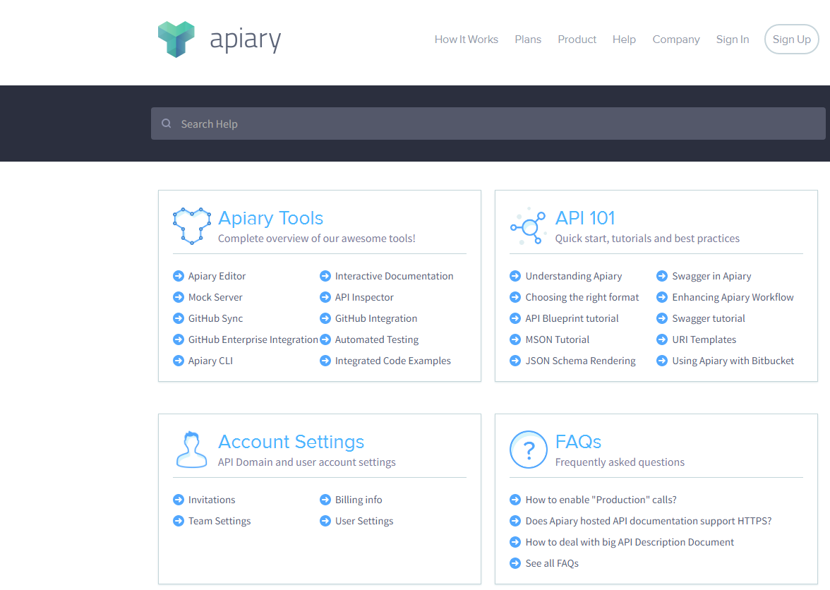
Notes:
https://help.apiary.io/
This is like your getting started / support page idea.

